Slide 1
The Chameleon Christian (Youth)
Quarterly youth service
Bible Verses:
James 1:7-8, 22-24, Gala 1: 10, Rom 12: 1-5
By
ARUOTURE EZEKIEL

Slide 2
What is A Chameleon ?
A chameleon is a type of lizard known for its remarkable ability to change colour. This adaptation serves several purposes, including camouflage, communication, and regulating body temperature in response to their environment.

Slide 3
Who Is A Chameleon Christian ?
A "chameleon Christian" refers to someone who changes their beliefs, values, and behaviour depending on the social or cultural context they find themselves in, rather than adhering consistently to the teachings of the Bible.

Slide 4
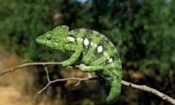
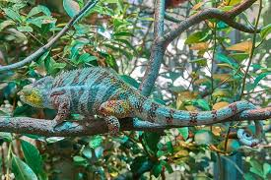
How Some of us (Youth) are

Slide 5
Characteristics Of A Chameleon Youth
Lack of Conviction
Chameleon youth often lack strong convictions and easily adapt their beliefs and values to fit in with their peers or societal trends.

Slide 6
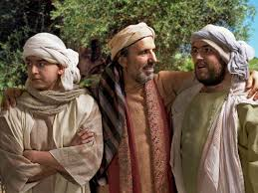
The Prodigal Son (luke 15:11-32)
the prodigal son represents a youth who succumbs to the temptations of the world and strays from his family and faith.

Slide 7
Peer Dependency (Conformity)
(Romans 12: 1-2)
Chameleon youth are heavily influenced by their peers and prioritize social acceptance above all else.

Slide 8
They may conform to the expectations of their peer group, even if it means compromising their own values or morals.

Slide 9
Inconsistency (Matthew 26:69-75)
Chameleon youth exhibit inconsistency in their behaviour, making it difficult for others to know their true character or values.
Apostle Peter denied knowing Jesus three times

Slide 10
Overcoming Chameleon Behaviour
Know Your Identity In Christ (Ephesians 1:4-5)
Ground your identity in your relationship with God rather than seeking validation from others or conforming to societal norms.

Slide 11
Surround Yourself With Positive Influences (2 Timothy 3:14-17)
Seek Out Mentors And Friends Who Will Encourage You In Your Faith And Hold You Accountable.
Paul's Relationship With Timothy Serves As A Model For Mentoring And Discipleship.

Slide 12
Be Transformed By Renewing Your Mind (Romans 12:2)
Continually renew your mind through the study of scripture and prayer, allowing God to transform your thoughts and behaviour.

Slide 13
Practice Assertiveness (Ephesians 4:15)
Learn to assert your opinions and boundaries respectfully, even if they differ from those around you. communicate your values and beliefs confidently without fear of rejection or judgment. (if you can’t beat them, go and hire people to beat them).

Slide 14
Don’t be ashamed to stand out among others

Slide 15
Embrace Vulnerability (Corinthians 12:9-10)
Be willing to be vulnerable and authentic with others, sharing your struggles and imperfections. vulnerability fosters genuine connections and allows others to see the real you.

Slide 16
Conclusion
Chameleon behaviour among youth can be detrimental to their spiritual growth and well-being, leading to a lack of conviction, dependency on peers, and identity crisis. Focusing on biblical instructions, youth can overcome chameleon behavior and live authentically for Christ.

Slide 17
THANK
YOU

